Slide 1
Credit EDA Case Study
Created by: Sumeet Rane
Date: 30/10/2022

Slide 2
Objective
This case study aims to identify patterns which indicate if a client has difficulty paying their instalments which may be used for taking actions such as denying the loan, reducing the amount of loan, lending (to risky applicants) at a higher interest rate, etc. This will ensure that the consumers capable of repaying the loan are not rejected.

Slide 3
Steps Taken
Understanding the domain/variables
Import/Load the data & Check the structure/metadata of the data.
Checking the missing values and making the required changes according to it
Performing Univariate & Bivariate Analysis.

Slide 4
Data Cleaning part
Removing null columns from application dataset & previous data dataset
Add median value to ‘AMT_ANNUITY’ column which has null values
Changing ‘XNA’ column to ‘F’ in Gender column
Removing unwanted columns

Slide 5
Now we will be dividing our data into two parts based on there ‘TARGET’ value.

Slide 6
Categorical Univariate analysis for Target 1

Slide 7
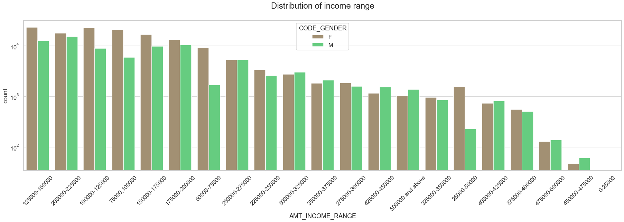
Distribution of Income range
Information gathered from the above graph
Very less count for income range 400000 and above.
Income range from 100000 to 200000 is having more number of credits.
This graph show that females are more than male in having credits for that range.
Female counts are higher than male.

Slide 8
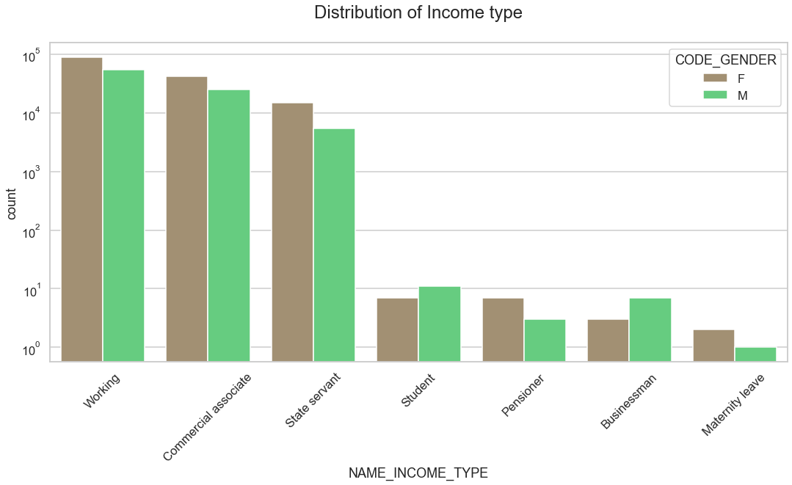
Distribution of Income type
Information gathered from the above graph
As seen above, income type ’commercial associate’, ‘State Servant’ and ‘working’ column the number of credits are higher than others.
Females Customers are having more number of credits than Male Customers.
For income type ‘student’ ,’pensioner’, ‘Businessman’ and ‘Maternity leave’ have less number of credits.

Slide 9
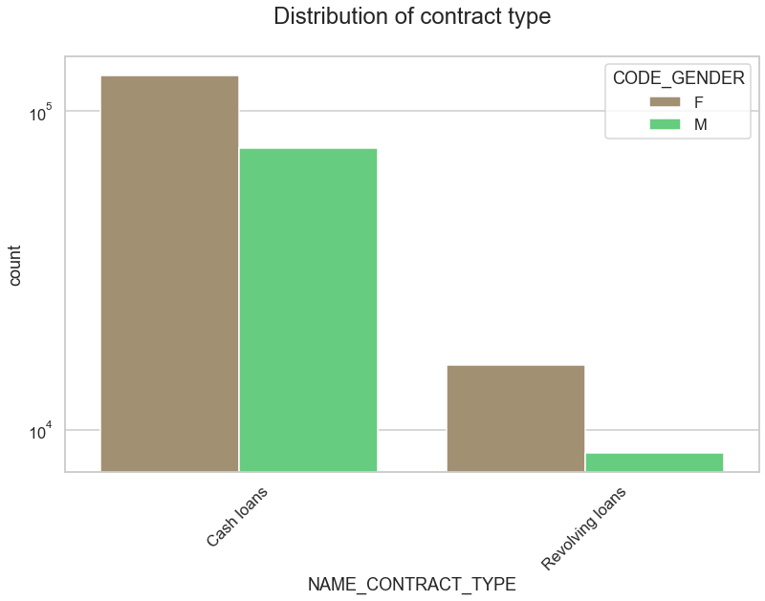
Distribution of contract type
Information gathered from the above graph
Type ‘cash loans’ is having higher number of credits than ‘Revolving loans’ contract type.
Female customers are leading for applying credits.

Slide 10
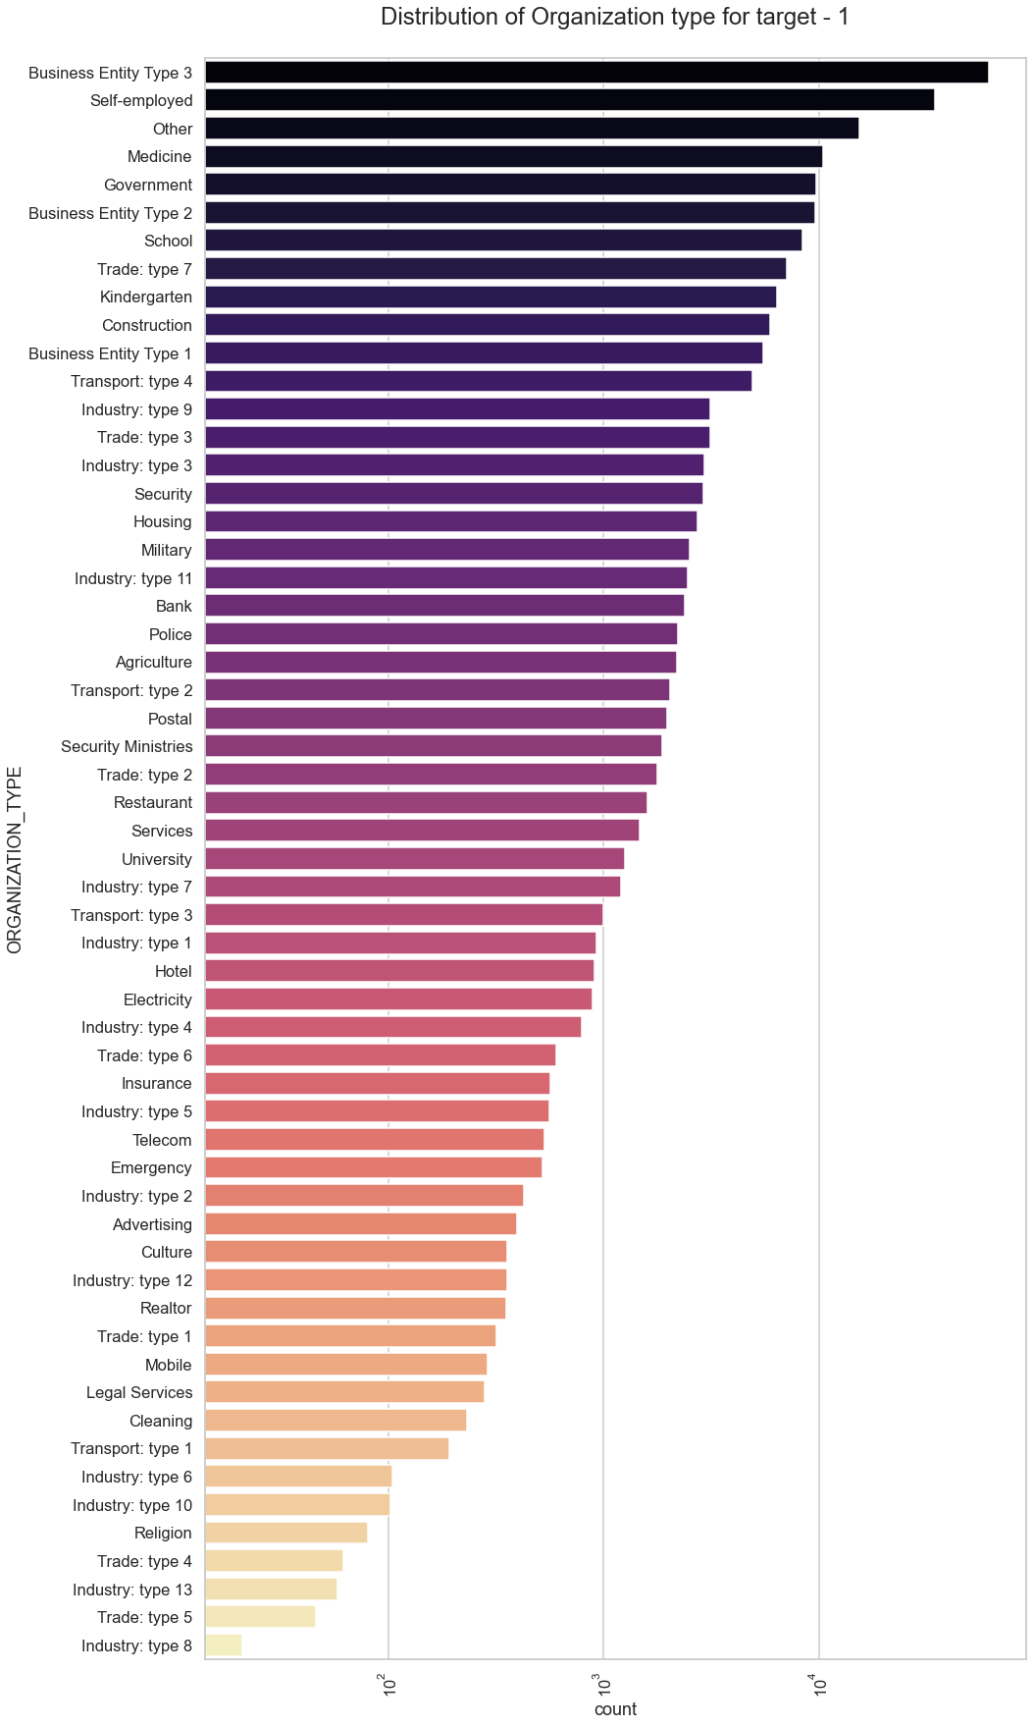
Distribution of Organization type for target - 1
Points to be concluded from the above graph.
Clients which have applied for credits are from most of the organization type ‘Business entity Type 3’ , ‘Self employed’, ‘Other’ , ‘Medicine’ and ‘Government’.
From Industry type 8,type 6, type 10, religion and trade type 5 & type 4 there are less clients.

Slide 11
Categorical Univariate analysis for Target 2

Slide 12
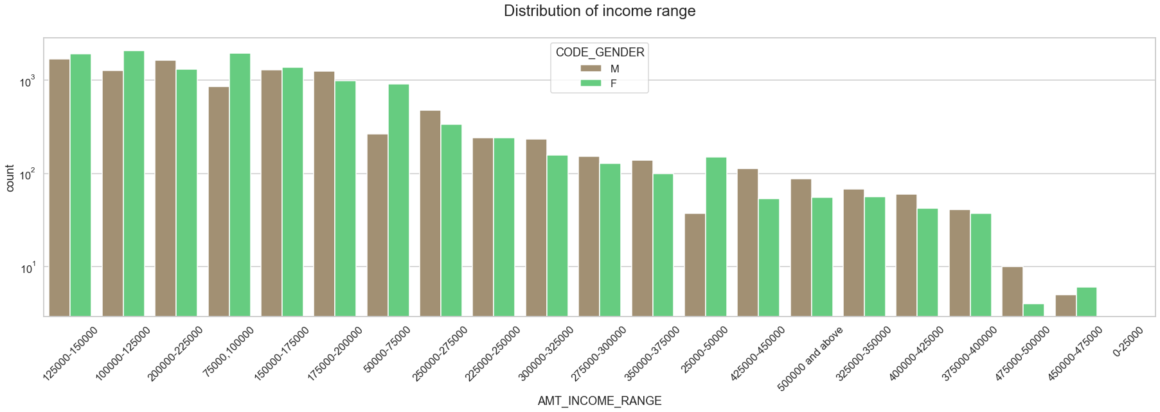
Distribution of Income range
Information gathered from the above graph
Male counts are higher compared to Female.
Income range from 100000 to 200000 are having more number of credits.
This graph show that Males count are more than Female count in having credits for that range.
For income range 400000 and above the count is very less.

Slide 13
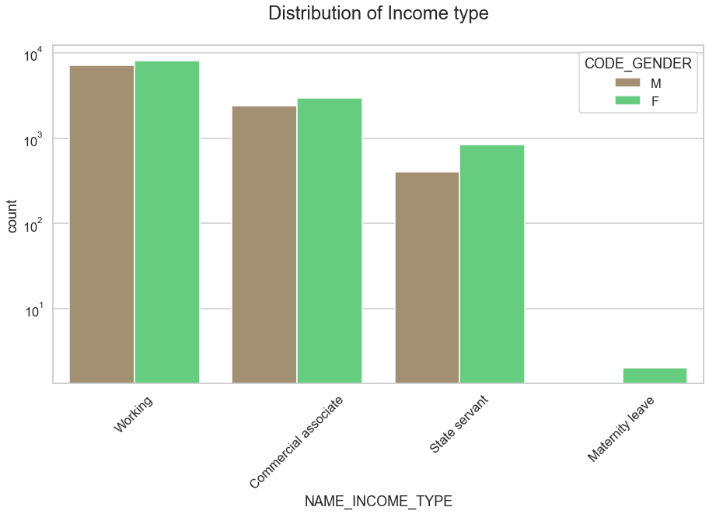
Distribution of Income type
Information gathered from the above graph
For income type ‘working’, ’commercial associate’, and ‘State Servant’ the number of credits are higher than other i.e. 'Maternity leave'.
The Females are having more number of credits than Male.
There are less number of credits for income type ‘Maternity leave’.
For type 1: There is no income type for ‘student’ , ’pensioner’ and ‘Businessman’ as they don’t do any late payments.

Slide 14
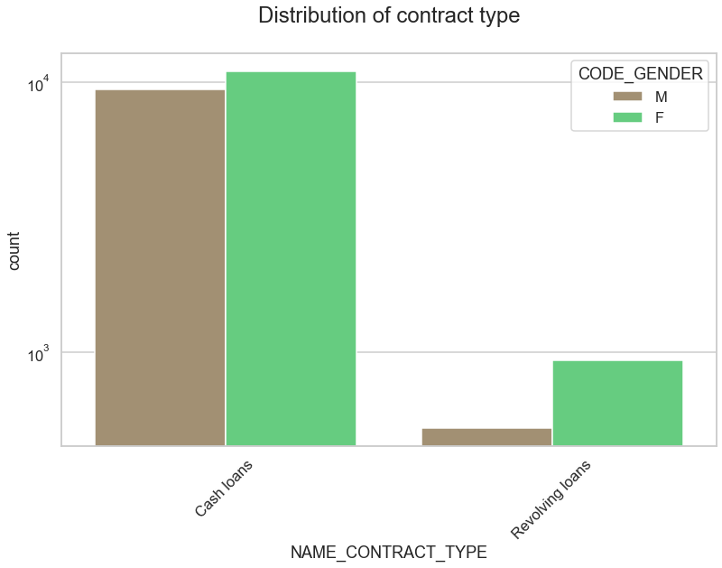
Distribution of contract type
Information gathered from the above graph
Contract type ‘cash loans’ is having higher number of credits than contract type ‘Revolving loans’ contract type.
Females are leading for applying credits.
For type 1 : there is only Female Revolving loans.

Slide 15
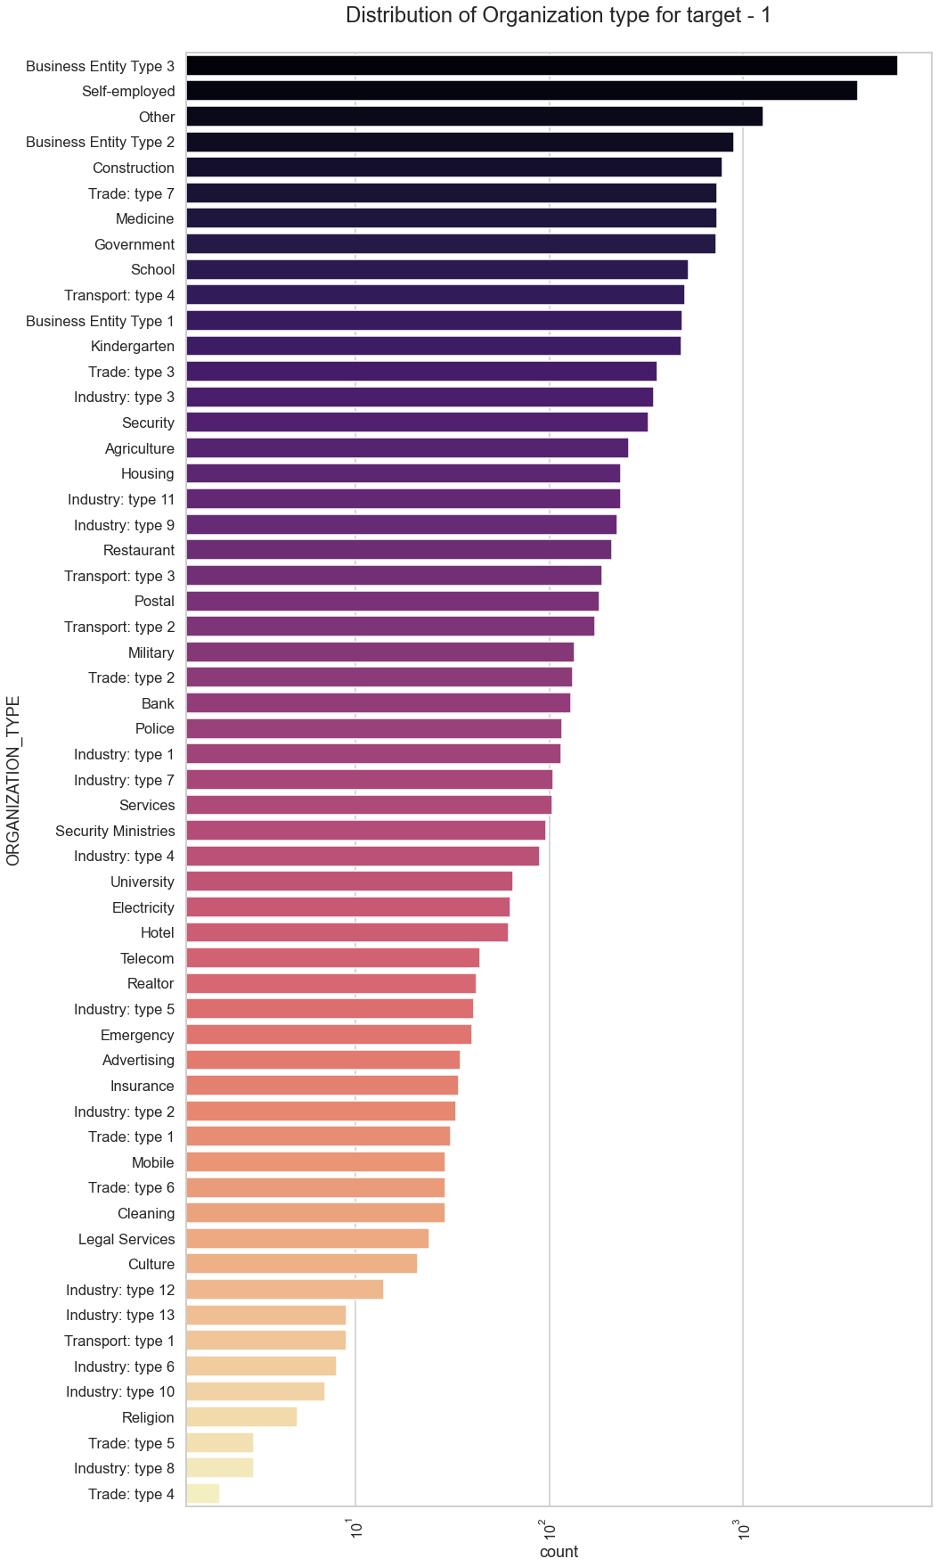
Distribution of Organization type for target - 1
Information gathered from the above graph
Clients which have applied for credits are from most of them are from organization type ‘Business entity Type 3’ , ‘Self employed’ , ‘Other’ , ‘Medicine’ and ‘Government’.
Less number of clients are from Industry type 8,type 6, type 10, religion and trade type 5, type 4.
Same as type 0 in distribution of organization type.

Slide 16
Now will be finding correlation for numerical columns from both the targets & view it in the form of Heat Maps

Slide 17
Correlation of target 1

Slide 18
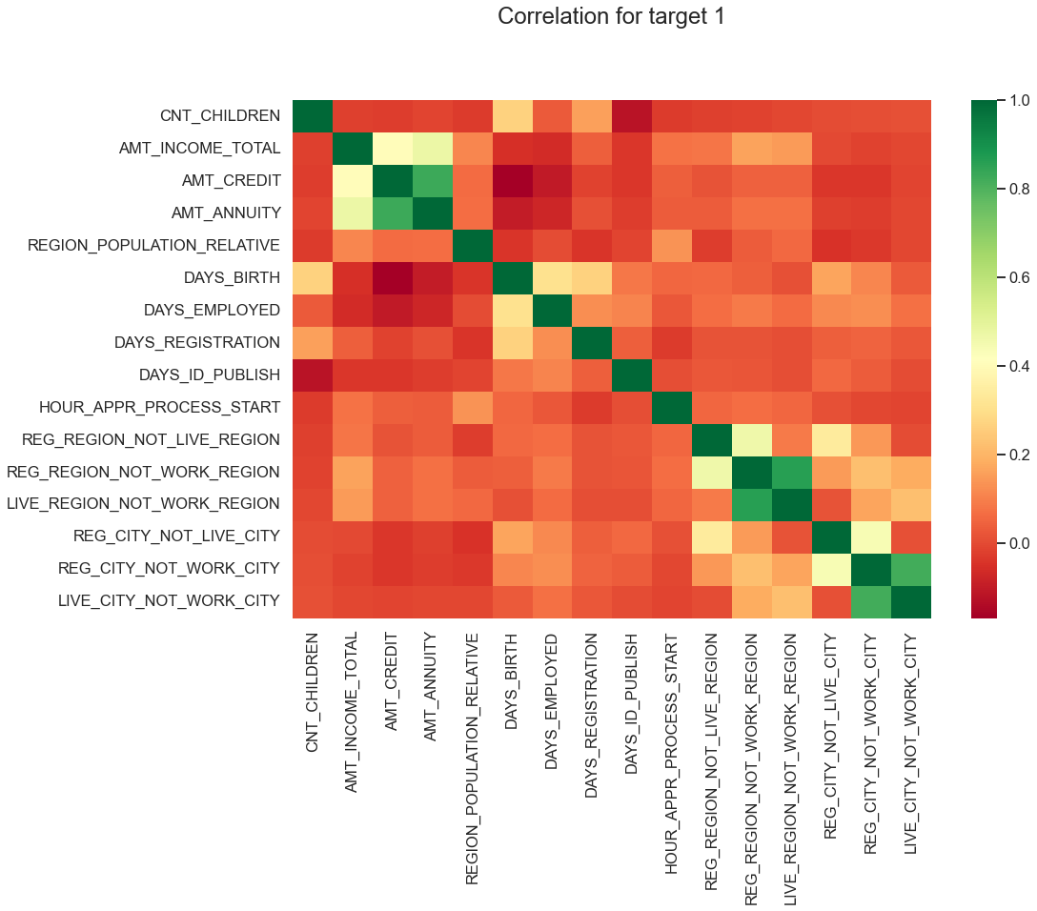
Information gathered from the above heatmap
Income amount is inversely proportional to the number of children client have, means more income for less children client have and vice-versa.
The income is also higher in densely populated area.
Credit amount is inversely proportional to the date of birth, which means Credit amount is higher for low age and vice-versa.
Credit amount is inversely proportional to the number of children client have, means Credit amount is higher for less children count client have and vice-versa.
Credit amount is higher to densely populated area.
less children client have in densely populated area.

Slide 19
Correlation of target 2

Slide 20
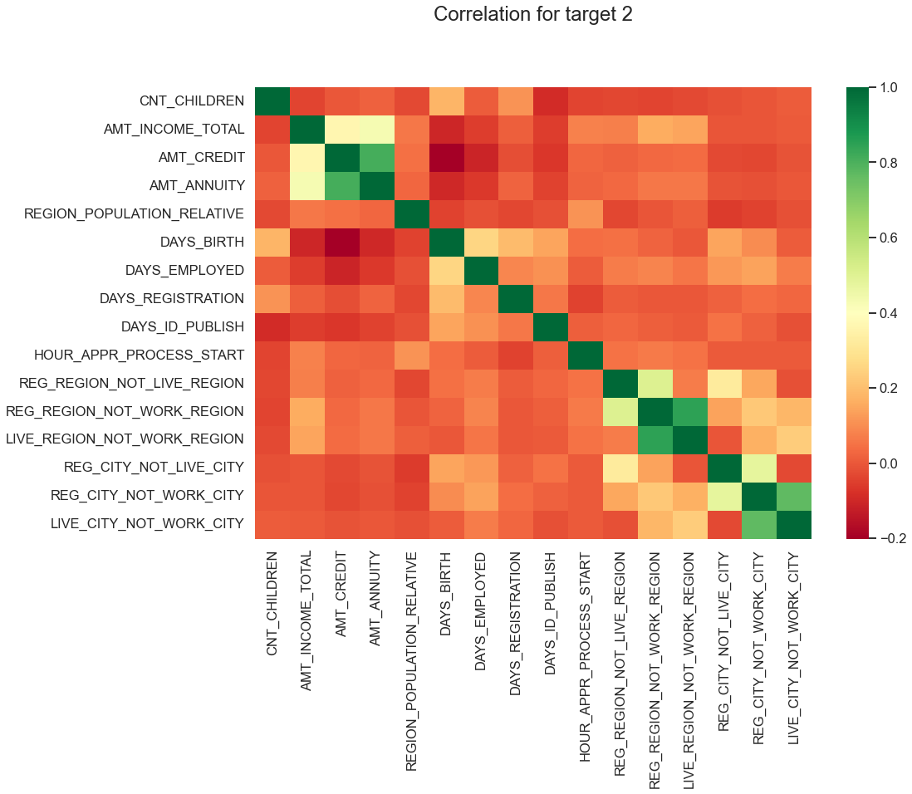
Information gathered from the above heatmap
Client's permanent address does not match work address are having less children and vice-versa
Client's permanent address does not match contact address are having less children and vice-versa

Slide 21
Categorical Univariate analysis for variables target 1

Slide 22
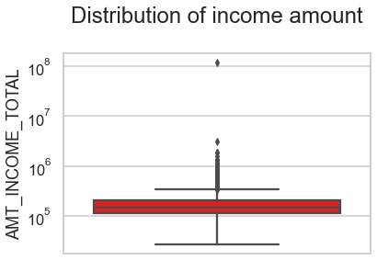
Distribution of income amount
Information gathered from the above boxplot
Some of the outliers are noticed in income amount.
The 3rd quartiles is very slim for income amount.

Slide 23
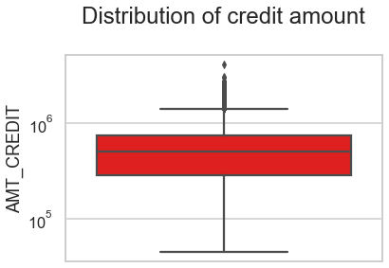
Distribution of credit amount
Information gathered from the above boxplot
Some of the outliers are noticed in the credit amount.
The 1st quartile is bigger than 3rd quartile for credit amount which means most of the credits of clients are present in the 1st quartile.

Slide 24
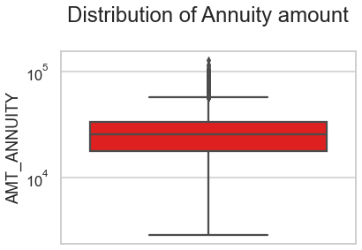
Distribution of Annuity amount
Information gathered from the above boxplot
Some of the outliers are noticed in the annuity amount.
The 1st quartile is bigger than 3rd quartile for annuity amount which means most of the annuity clients are from 1st quartile.

Slide 25
Categorical Univariate analysis for variables target 2

Slide 26
Distribution of income amount
Information gathered from the above boxplot
Some of the outliers are noticed in the income amount.
The 3rd quartiles is very slim for income amount.
Most of the clients of income are present in 1st quartile.

Slide 27
Distribution of credit amount
Information gathered from the above boxplot
Some of the outliers are noticed in the credit amount.
The 1st quartile is bigger than 3rd quartile for credit amount which means most of the credits of clients are present in the 1st quartile.

Slide 28
Distribution of Annuity amount
Information gathered from the above boxplot
Some of the outliers are noticed in the annuity amount.
The 1st quartile is bigger than 3rd quartile for annuity amount which means most of the annuity clients are from 1st quartile.

Slide 29
Bivariate analysis for type 1

Slide 30
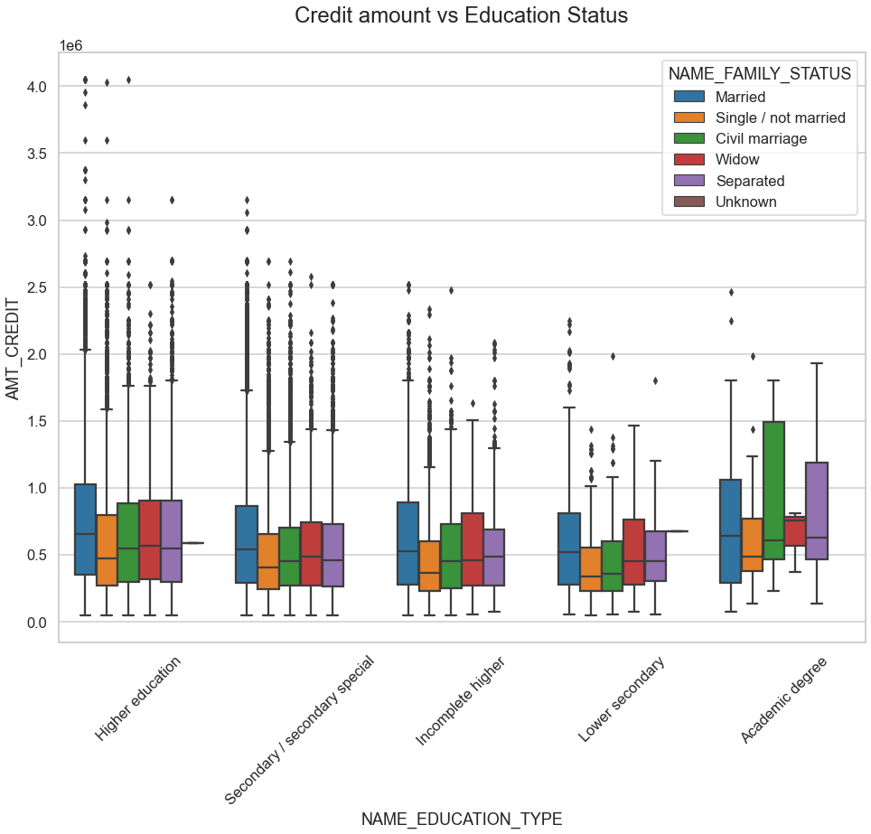
From the boxplot we can say that Family status of 'civil marriage', 'marriage' and 'separated' of Academic degree education are having higher number of credits than others.
The higher education of family status of 'marriage', 'single' and 'civil marriage' are having more outliers.
Civil marriage for Academic degree is having most of the credits in the third quartile.

Slide 31
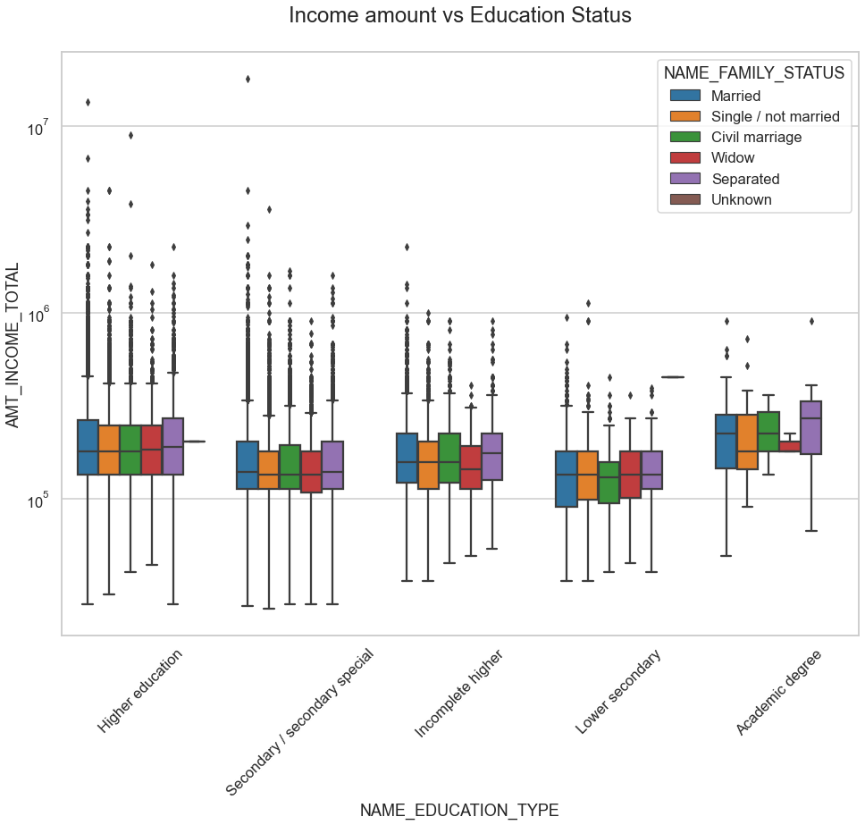
From above boxplot for Education type 'Higher education' the income amount is mostly equal with family status.
It does contain many outliers.
Less outlier are having for Academic degree but there income amount is little higher that Higher education.
Lower secondary of civil marriage family status are have less income amount than others.

Slide 32
Bivariate analysis for type 2

Slide 33
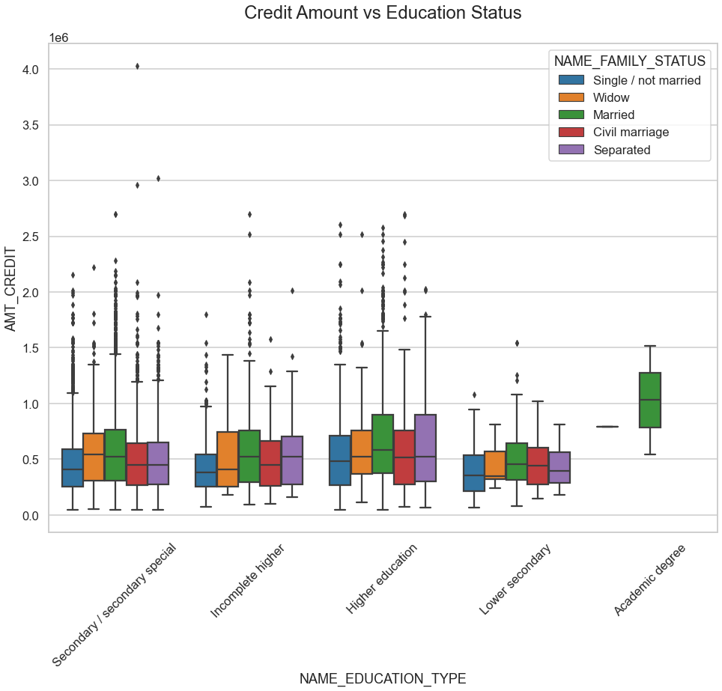
From the above box plot we can say that Family status of 'civil marriage', 'marriage' and 'separated' of Academic degree education are having higher number of credits than others.
Most of the outliers are from Education type 'Higher education' and 'Secondary'.
Civil marriage for Academic degree is having most of the credits in the third quartile.

Slide 34
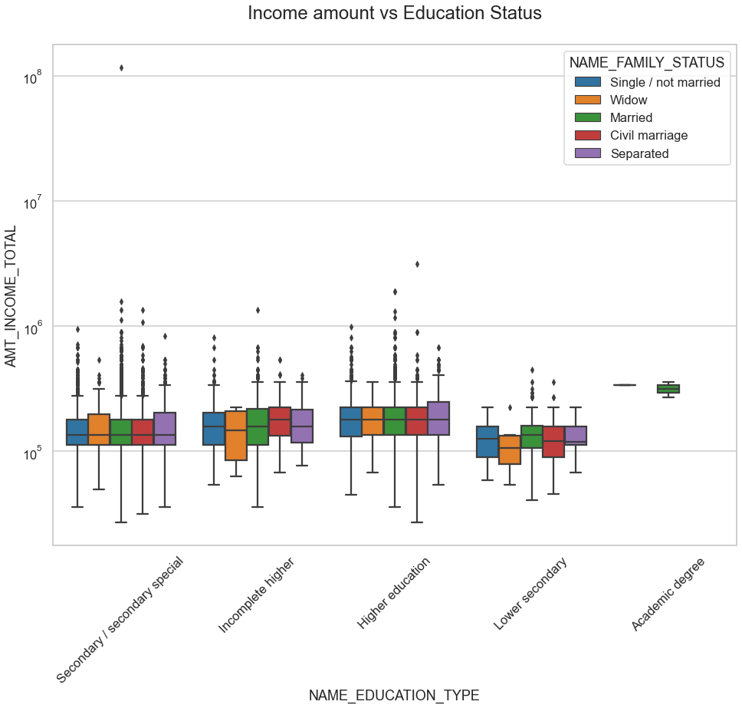
From above boxplot for Education type 'Higher education' the income amount is mostly equal with family status.
Less outlier are having for Academic degree but there income amount is little higher that Higher education.
Lower secondary are have less income amount than others.

Slide 35
Now we will be merging our application dataset & previous data dataset and perform analysis on it

Slide 36
Univariate analysis after merging previous data

Slide 37
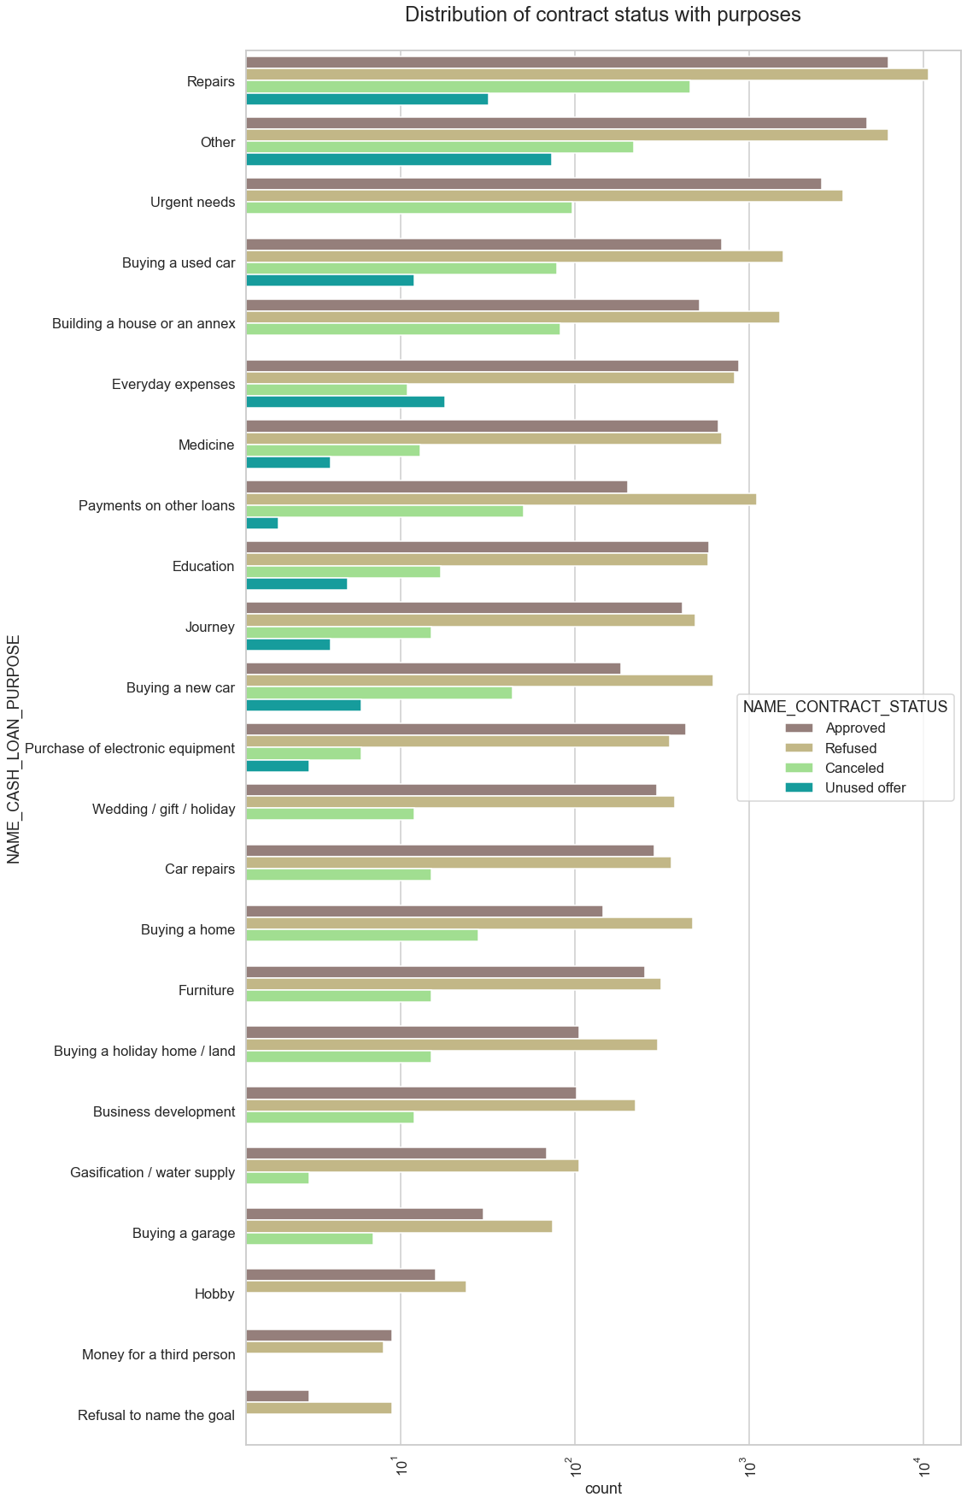
Distribution of contract status with purposes
Information gathered from the above graph
Most of loan rejections came from purpose 'repairs'.
Loan taken for education purposes we have equal number of approves and rejection
Paying other loans and buying a new car is having significant higher rejection than approves.

Slide 38
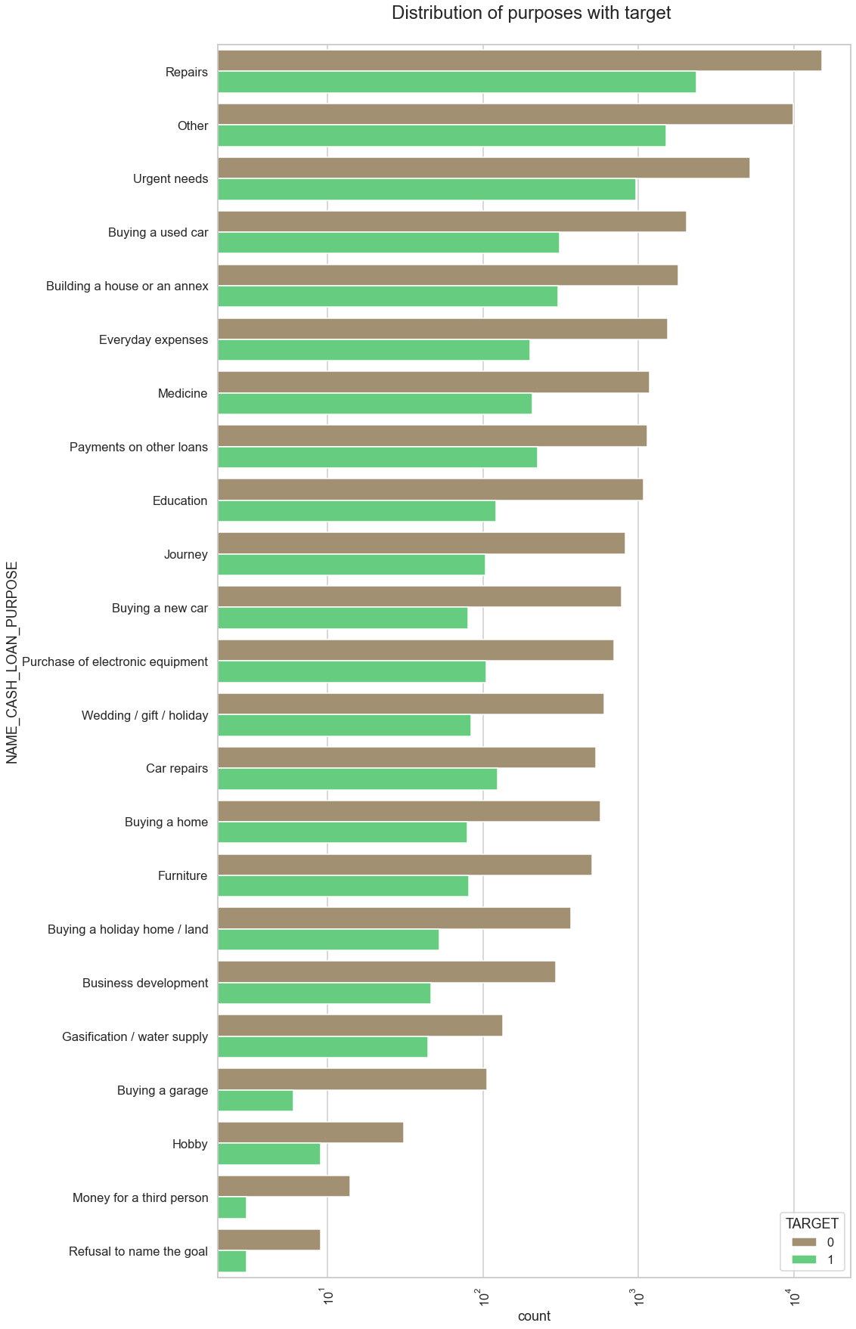
Distribution of purposes with target
Information gathered from the above graph
Loans taken with the purposes of 'Repairs' are facing more difficulties in payment on time.
There are few places where loan payment is significant higher than facing difficulties.
They are 'Buying a garage', 'Business development', 'Buying land','Buying a new car' and 'Education'
Hence we can focus on these purposes for which the client is having for minimal payment difficulties.

Slide 39
Performing bivariate analysis

Slide 40
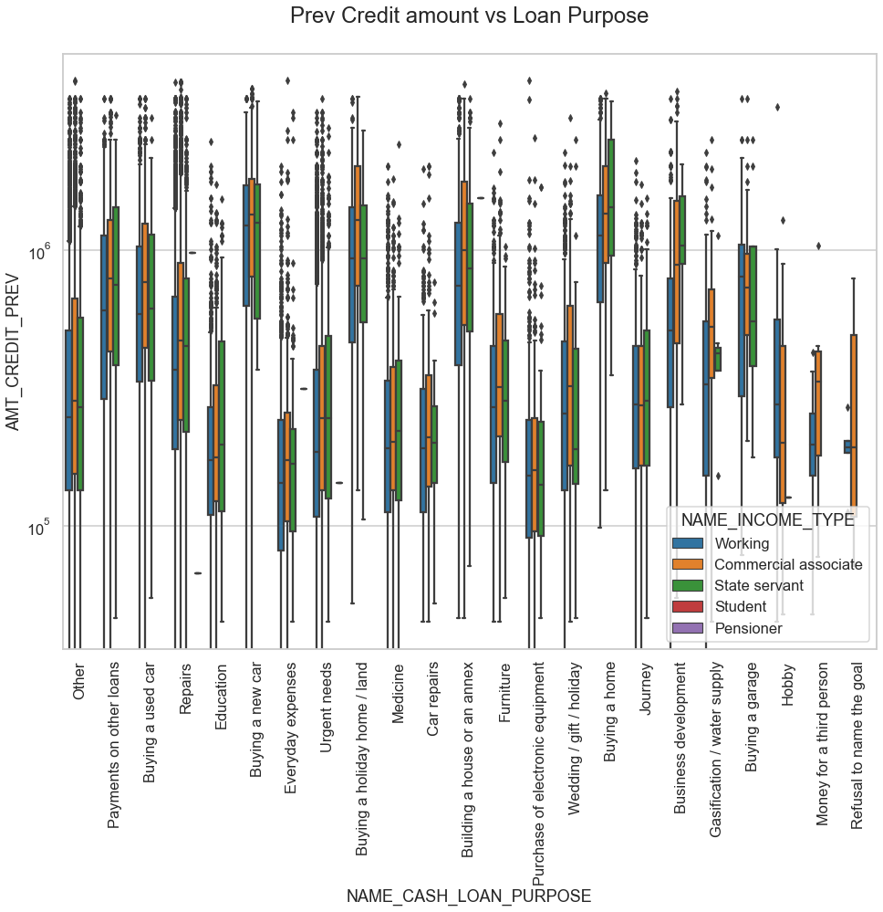
Prev Credit amount vs Loan Purpose
Information gathered from the above graph
The credit amount of Loan purposes like 'Buying a home','Buying a land','Buying a new car' and Building a house' is higher compared to others.
Income type of state servants have a significant amount of credit applied.
Money for 3rd person or a Hobby is having less credits applied for.

Slide 41
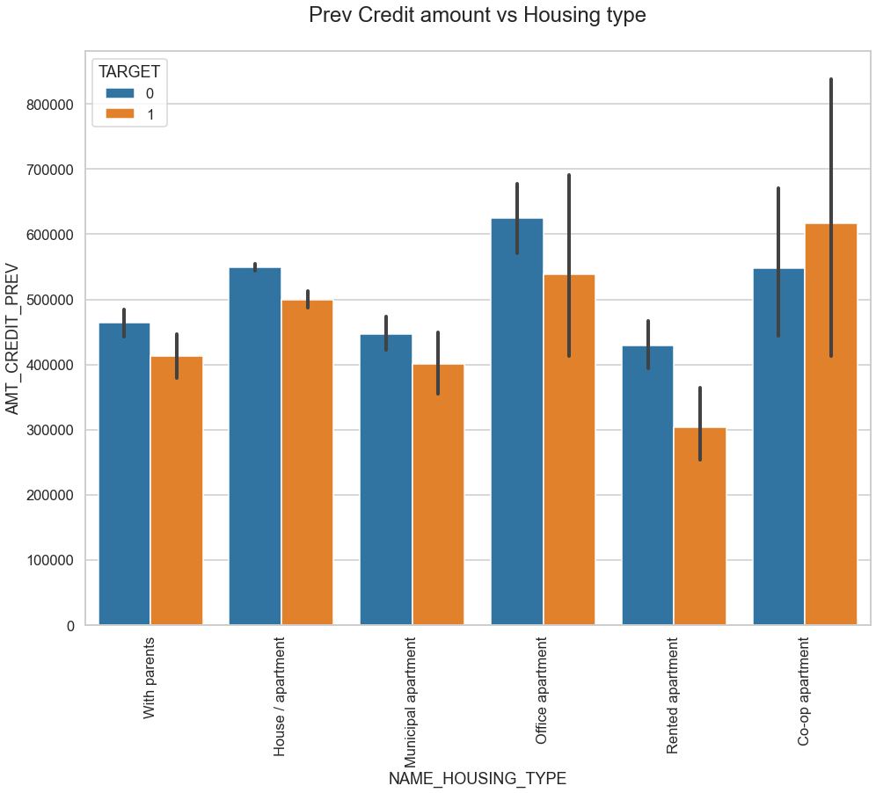
Prev Credit amount vs Housing type
Information gathered from the above graph
For Housing type office apartment is having higher credit of target 1 and co-op apartment is having higher credit of target 2.
We can conclude that bank should avoid giving loans to the housing type of co-op apartment as they are having difficulties in payment.
Bank can focus mostly on housing type with parents or House\apartment or municipal apartment for successful payments of loans.

Slide 42
Conclusion
Banks should focus more on contract type of ‘Student’ ,’pensioner’ and ‘Businessman’ with housing ‘type other than ‘Co-op apartment’ for successful payments of there loan, as they have better chances of completing the loan.
According to our data banks should focus less on income type ‘Working’ as they are having most number of unsuccessful payments of there loan.
Also with loan purpose ‘Repair’ is having higher number of unsuccessful payments of there loan amount on time.
Get as much as clients from housing type ‘With parents’ as they are having least number of unsuccessful payments of loan amount.

Slide 43
THE END

